Slide 1

DEEP NEURAL NETWORK MODULE # 4 : LINEAR NEURAL NETWORKS FOR CLASSIFICATION
DNN Team
BITS Pilani WILP

Slide 2
The instructor is gratefully acknowledging the authors who made their course materials freely available online.
This deck is prepared by Seetha Parameswaran.
Deep Learning
2 / 100

Slide 3





Table of Contents
1
Classification
Binary Classification
Logistic Regression
The Model: Single Neuron for Binary Classification
Binary Classification: Worked Example
Binary Classification: Evaluation Metrics
Multi-class Classification
Multi-class Classification Model
Mini-batch Stochastic Gradient Descent
Multiclass Classification: Worked Example
Making Predictions (Inference)
Multiclass Classification: Evaluation Metrics
Implementation Tips and Debugging
Summary
2
3
4
5
Deep Learning
3 / 100

Slide 4
What is Classification?
Definition
Classification is a supervised learning task that predicts a discrete category or class label based on input features.
Key Characteristics:
Input: Feature vector x ∈ R^{d}
Output: Class label y ∈ {1, 2, . . . , K } (discrete)
Goal: Learn a function f : R^{d} → {1, 2, . . . , K } that assigns inputs to classes
Difference from Regression:
Regression: Predicts continuous values (e.g., price, temperature) Classification: Predicts discrete categories (e.g., spam/not spam, cat/dog)
Deep Learning
4 / 100

Slide 5
Examples of Classification Problems
1
Email Spam Detection
Input: Email text, sender information, attachments
Output: Spam or Not Spam
Medical Diagnosis
Input: Patient symptoms, test results, medical history
Output: Disease present or absent
Image Recognition
Input: Pixel values of an image
Output: Object category (cat, dog, car, etc.)
Sentiment Analysis
Input: Customer review text
Output: Positive, Negative, or Neutral
2
3
4
Deep Learning
5 / 100

Slide 6
Types of Classification
Binary Classification
Two classes: y ∈ {0, 1} or {−1, +1}
Examples: Spam detection, disease diagnosis, fraud detection
Multi-class Classification
Multiple classes: y ∈ {1, 2, . . . , K } where K > 2 Examples: Digit recognition (0-9), animal classification Each example belongs to exactly one class
Multi-label Classification
Each example can belong to multiple classes simultaneously Examples: Movie genres (action + comedy), document tagging
Deep Learning
6 / 100

Slide 7


Table of Contents
Classification
Binary Classification
Logistic Regression
The Model: Single Neuron for Binary Classification
Binary Classification: Worked Example
Binary Classification: Evaluation Metrics
Multi-class Classification
Multi-class Classification Model
Mini-batch Stochastic Gradient Descent
Multiclass Classification: Worked Example
Making Predictions (Inference)
Multiclass Classification: Evaluation Metrics
Implementation Tips and Debugging
Summary
1
2
3
4
5
Deep Learning
7 / 100

Slide 8
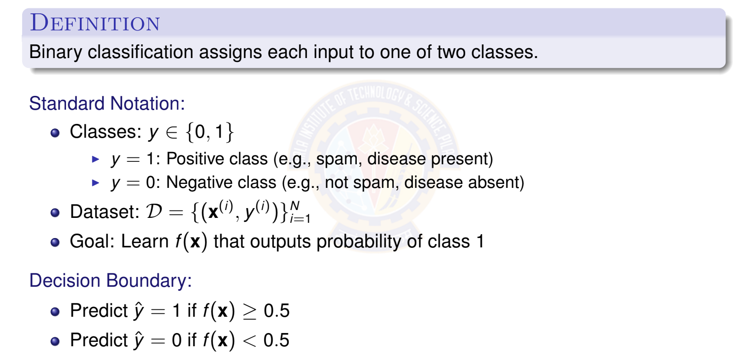
Binary Classification Problem
Deep Learning
8 / 100

Slide 9
Binary Classification: Visual Example
x₂
Decision Boundary
Region 1
The decision boundary
separates the two classes in feature space.
Region 0
x₁
Class 0
× Class 1
Deep Learning
9 / 100

Slide 10
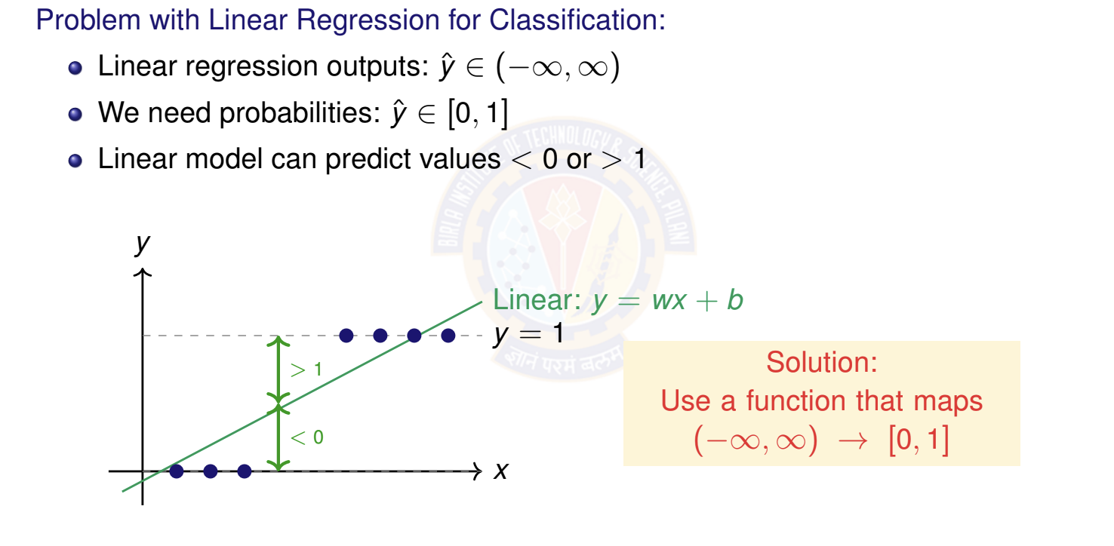
Why Not Use Linear Regression?
Deep Learning

Slide 11



Table of Contents
Classification
Binary Classification
Logistic Regression
The Model: Single Neuron for Binary Classification
Binary Classification: Worked Example
Binary Classification: Evaluation Metrics
Multi-class Classification
Multi-class Classification Model
Mini-batch Stochastic Gradient Descent
Multiclass Classification: Worked Example
Making Predictions (Inference)
Multiclass Classification: Evaluation Metrics
Implementation Tips and Debugging
Summary
1
2
3
4
5
Deep Learning

Slide 12
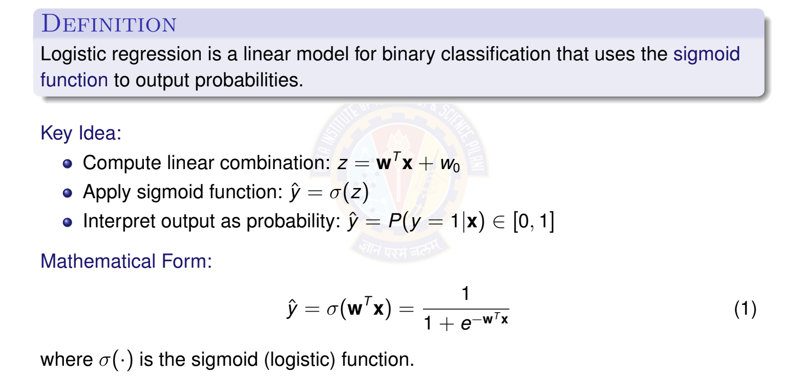
What is Logistic Regression?
Deep Learning
12 / 100

Slide 13
The Sigmoid Activation Function
Sigmoid (Logistic) Function: σ (z) =
1
1+e
−z
Derivative formula: σ ^{r}(z) = σ (z)(1 − σ (z))
Function
σ (z)
Derivative
σ ^{r}(z)
0.3
(0, 0.25)
1
0.2
0.5
(0, 0.5)
0.1
z
z
−5
5
−5
5
At z = 0: σ (0) = 0.5
σ^{r}(0) = 0.25
Deep Learning

Slide 14
Properties of Sigmoid Function
Key Properties:
Range: σ (z) ∈ (0, 1) → perfect for probabilities!
Monotonic: Always increasing
Smooth: Differentiable everywhere
Symmetry: σ (−z) = 1 − σ (z)
Derivative: σ^{r}(z) = σ (z)(1 − σ (z))
Behavior:
When z → +∞: σ (z) → 1 (confident class 1)
When z → −∞: σ (z) → 0 (confident class 0)
When z = 0: σ (z) = 0.5 (uncertain)
The derivative property makes sigmoid ideal for gradient-based learning!
Deep Learning

Slide 15
Table of Contents
Classification
Binary Classification
Logistic Regression
The Model: Single Neuron for Binary Classification
Binary Classification: Worked Example
Binary Classification: Evaluation Metrics
Multi-class Classification
Multi-class Classification Model
Mini-batch Stochastic Gradient Descent
Multiclass Classification: Worked Example
Making Predictions (Inference)
Multiclass Classification: Evaluation Metrics
Implementation Tips and Debugging
Summary
1
2
3
4
5
Deep Learning

Slide 16
The Four Components
A complete deep learning system for classification consists of:
Data: d -dimensional input vectors and binary labels Model: Single neuron with sigmoid activation Objective Function: Binary cross-entropy loss
Learning Algorithm: Stochastic gradient descent (SGD)
1
2
3
4
Note: We use stochastic gradient descent instead of batch gradient descent for efficiency. (This is for learning purposes only.)
Deep Learning

Slide 17
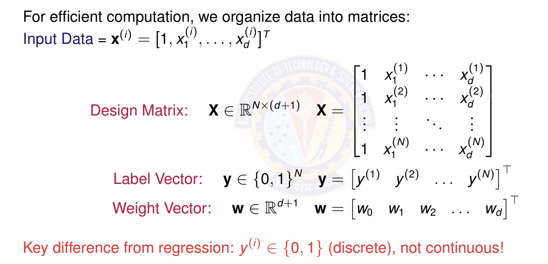
Matrix Form of Data
Deep Learning

Slide 18
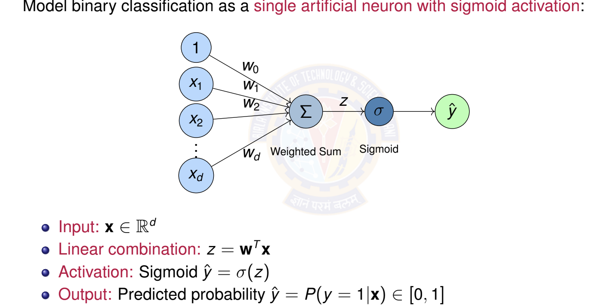
Logistic Regression as a Single Neuron
Deep Learning

Slide 19
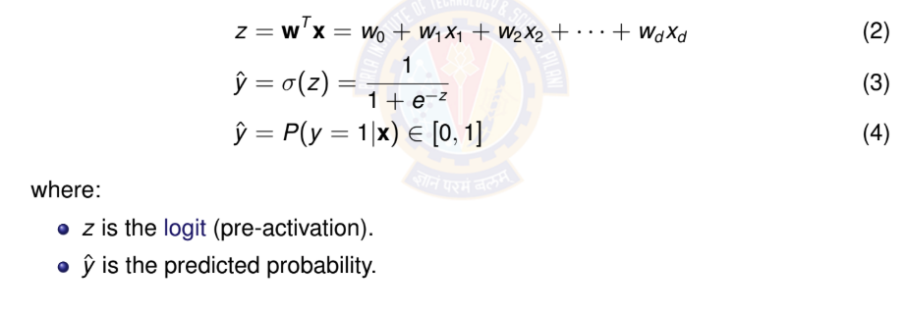
Model Prediction
Model: A single neuron computes weighted sum and applies sigmoid activation. Prediction for input x:
Deep Learning

Slide 20
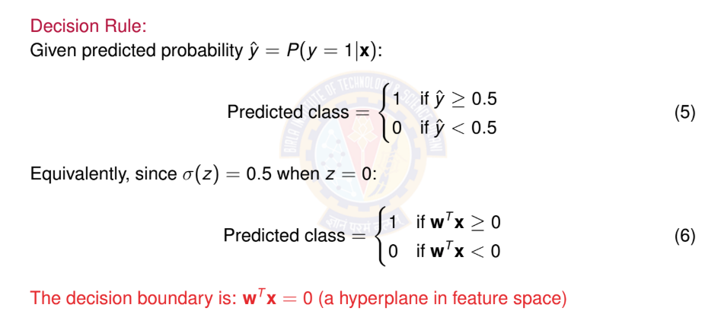
Making Predictions
Deep Learning

Slide 21
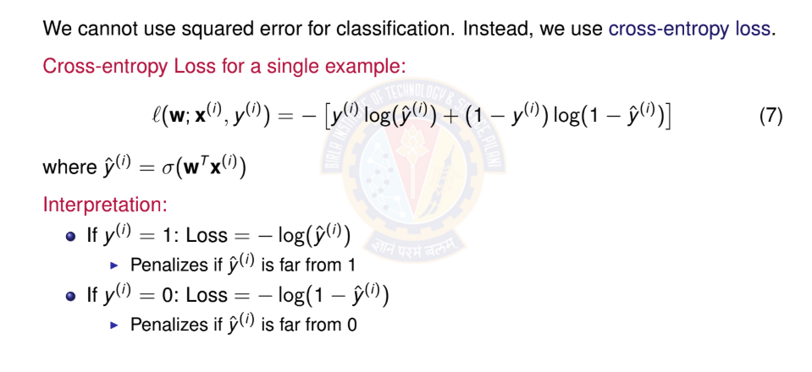
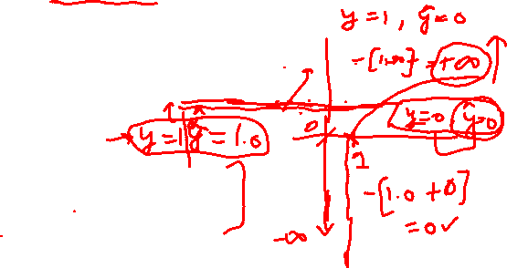
Binary Cross-Entropy Loss
Deep Learning
Notes:
Cross-entropy loss is a metric that measures the difference between two probability distributions, for classification tasks to compare a model's predicted probabilities against the true probabilities.
A lower cross-entropy loss indicates that the model's predictions are closer to the true labels, while a higher loss signifies a larger discrepancy. By minimizing this loss during training, a model can improve its predictive accuracy.

Slide 22
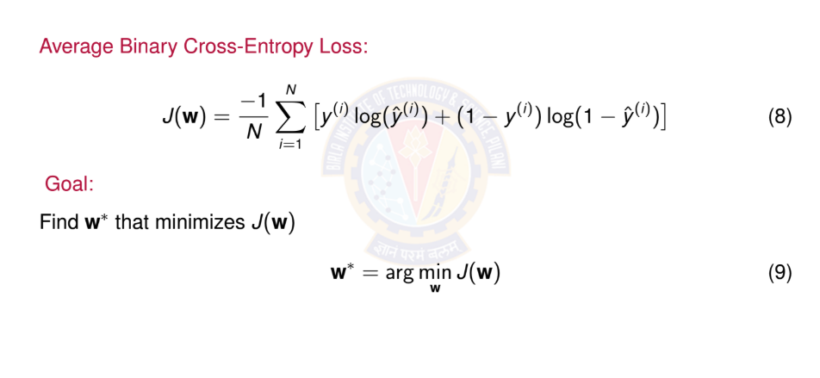

Total Loss Function
Deep Learning

Slide 23
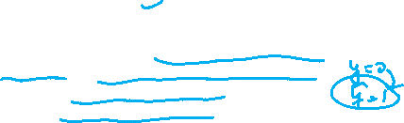
Why Cross-Entropy Loss?
Advantages:
Probabilistic interpretation: Derived from maximum likelihood estimation Appropriate for probabilities: Heavily penalizes confident wrong predictions Convex: Has a single global minimum for logistic regression
Well-behaved gradients: Works well with sigmoid activation
Loss behavior: Loss increases exponentially as prediction diverges from true label!
Loss
4
2
yˆ (prediction)
0.2 0.4 0.6 0.8
1
Deep Learning

Slide 25
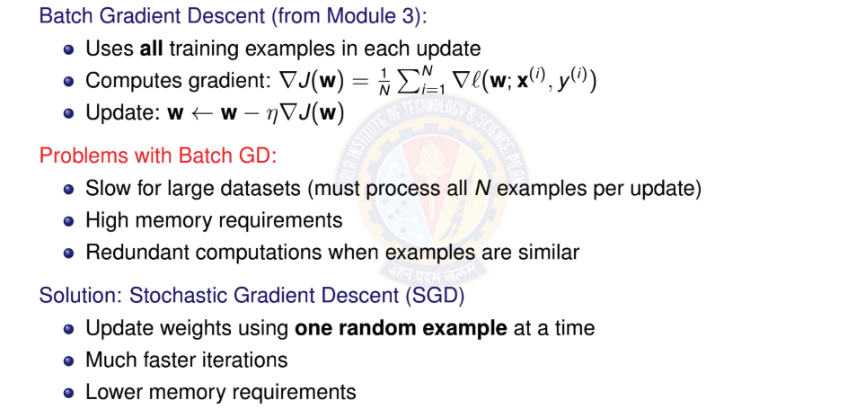
From Batch to Stochastic Gradient Descent
Deep Learning

Slide 26
Stochastic Gradient Descent (SGD)
Key Idea:
Instead of computing gradient over entire dataset, use gradient from a single ran- dom example.
SGD Update Rule: At iteration t :
Randomly select one example (x^{(i)}, y ^{(i)})
Compute gradient for this example: ∇l(w; x^{(i)}, y ^{(i)}) (noisy gradient estimate) Update weights: w^{(t +1)} = w^{(t )} − η∇l(w^{(t )}; x^{(i)}, y ^{(i)})
1
2
3
The noise in SGD actually helps escape local minima and often leads to better gen- eralization!
Deep Learning
Notes:
Stochastic Gradient Descent (SGD) is an optimization algorithm that iteratively updates model parameters to minimize a loss function, similar to traditional gradient descent but using a single training example or a small batch to compute the gradient at each step. This approach makes SGD computationally efficient and faster for large datasets, as it avoids the cost of processing the entire dataset at once

Slide 27
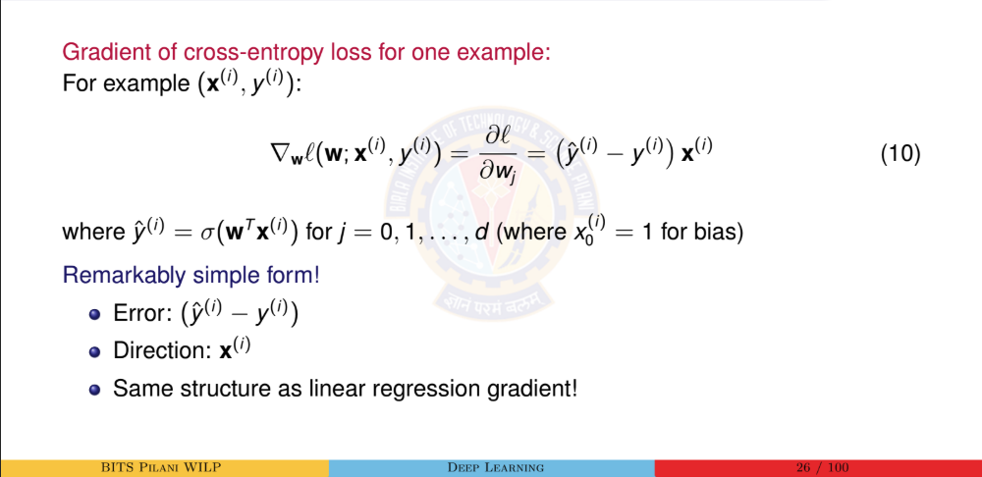
Computing the Gradient for SGD

Slide 28

References
Zhang, A., Lipton, Z. C., Li, M., & Smola, A. J. (2023). Dive into Deep Learning. Cambridge University Press. Chapter 4 (Linear Neural Networks for Classification). https://d2l.ai/
Goodfellow, I., Bengio, Y., & Courville, A. (2016). Deep Learning. MIT Press. Chapter 6 (Deep Feedforward Networks). https://www.deeplearningbook.org/
Bishop, C. M. (2006). Pattern Recognition and Machine Learning. Springer. Chapter 4 (Linear Models for Classification).
Murphy, K. P. (2022). Probabilistic Machine Learning: An Introduction. MIT Press. Chapter 10 (Logistic Regression). https://probml.github.io/pml-book/
Deep Learning

